Slide 1

Introduction
University of Science, VNU-HCM
Faculty of Information Technology
Assoc. Prof. TRAN Minh Triet
Department of Software Engineering
Software Analysis and Design

Slide 2

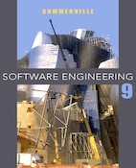
References
Software Engineering: A Practitioner's Approach (7th Edition)
by Roger S Pressman
McGraw-Hill, 2009
Software Engineering (9th Edition)
by Ian Sommerville
Addison Wesley, 2010
Course “Mastering Object-Oriented Analysis and Design with UML 2.0”
by IBM Software Group

Slide 3
What is software?
“Computer programs and associated documentation. Software products may be developed for a particular customer or may be developed for a general market.”
(Ian Sommerville, Software Engineering (9th Edition), Addison Wesley, 2010)
“Software is (1) instructions (computer programs) that when executed provide desired function and performance, (2) data structures that enable the programs to adequately manipulate information, and (3) documents that describe the operation and use of the programs.”
(Roger S Pressman, Software Engineering: A Practitioner's Approach (7th Edition), McGraw-Hill, 2009)
“Computer software is the product that software engineers design and build. It encompasses programs that execute within a computer of any size and architecture, documents that encompass hard-copy and virtual forms, and data that combine numbers and text but also includes representations of pictorial, video, and audio information.”
(Roger S Pressman, Software Engineering: A Practitioner's Approach (7th Edition), McGraw-Hill, 2009)

Slide 4
What is software?
What is the concept of software that I was taught when I was an undergraduate student?
“Chương trình thực thi được trên máy tính nhằm hỗ trợ cho các nhà chuyên môn trong từng lĩnh vực chuyên ngành thực hiện tốt hơn các thao tác nghiệp vụ của mình
(From the lectures on Software Engineering of Prof. NGUYEN Tien Huy, HCMUS, VNU-HCM, 1999)

Slide 5
What is software?
Executing environment for software:
Traditional computing environment: mainframes, computers, laptops, …
Mobile devices: smart phones, PDAs, tablet PCs…
Other devices: set-top boxes, cameras, routers, firewalls…
How to provide better services to users?
Computerize business processes that are being processed manually
Improve existing computerized functionalities of business processes
Propose and develop new functionalities for new/existing business processes

Slide 6
Software applications
Some types of software applications:
System software
Real-time software
Business software
Engineering and scientific software
Embedded software
Personal computer software
Web-based software
Artificial intelligence software
…

Slide 7
What is software engineering?
“Software engineering is an engineering discipline which is concerned with all aspects of software production.”
(Ian Sommerville, Software Engineering (9th Edition), Addison Wesley, 2010)
“[Software engineering is] the establishment and use of sound engineering principles in order to obtain economically software that is reliable and works efﬁciently on real machines.”
(Fritz Bauer, Software Engineering: A Report on a Conference Sponsored by the NATO Science Committee, NATO, 1969, Editors: P. Naur and B. Randall)
“Software Engineering:
The application of a systematic, disciplined, quantiﬁable approach to the development, operation, and maintenance of software; that is, the application of engineering to software.
The study of approaches as in (1).”
(IEEE Standards Collection: Software Engineering, IEEE Standard 610.12—1990, IEEE, 1993.)

Slide 8

Software engineering layers
Process deﬁnes a framework for a set of key process areas that must be established for effective delivery of software engineering technology.
Software engineering methods provide the technical how-to's for building software.
Software engineering tools provide automated or semi-automated support for the process and the methods.
Software engineering layers
(Source: Roger S Pressman, Software Engineering:
A Practitioner's Approach (7th Edition), McGraw-Hill, 2009)

Slide 9
Software production lines
Software product lines or application families:
A product line is a set of applications with a common application-specific architecture. Each specific application is specialised in some way
An application type is generalised around a common architecture so that it can be adapted for different customers.
(Ian Sommerville, Software Engineering (9th Edition), Addison Wesley, 2010)
Some types of specialisation of a software product line:
Platform specialisation
Environment specialisation
Functional specialisation
Process specialisation

Slide 10
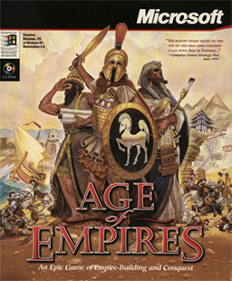
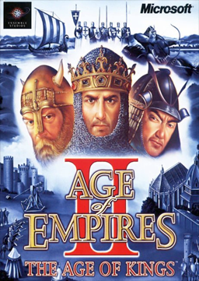
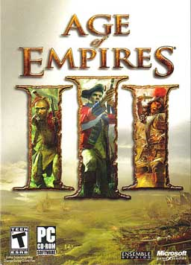
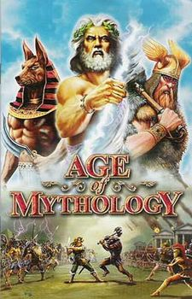
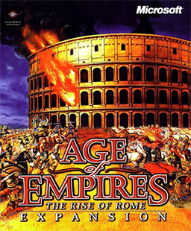
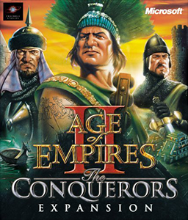
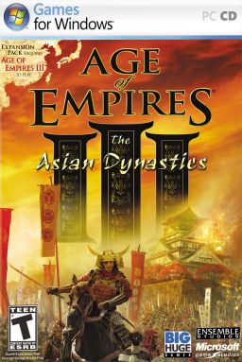
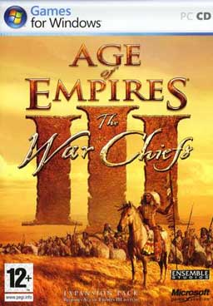
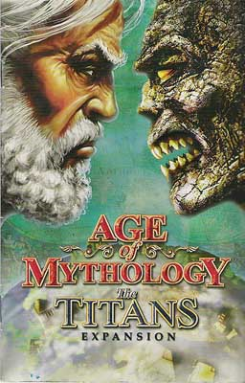
Software production lines
Age of Empires
Age of Empires II
Age of Empires III
Age of Mythology
The rise of Rome
The Conquerors
The Asian Dynasties
The WarChiefs
The Titans

Slide 11
What are the attributes of good software?
The software should deliver the required functionality and performance to the user and should be maintainable, dependable and usable.
(Ian Sommerville, Software Engineering (9th Edition), Addison Wesley, 2010)

Slide 12
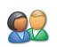


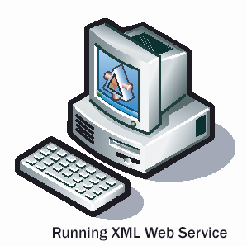

Characteristics of a good software?
Correctness:
Completeness
Accuracy
User
Correctness
Software
Other software
Hardware
From a user’s view point

Slide 13
Characteristics of a good software?
Ease of use
Correctness
Ease of use:
Easy to be familiar with
Easy/convenient to be used
Use in the most natural way
User
Software
Other software
Hardware
From a user’s view point

Slide 14
Characteristics of a good software?
Correctness
Ease of use
Efficiency:
Optimize for processing*
Optimize for storage*
Other optimizations?
User
Software
Efficiency
Other software
Hardware
From a user’s view point

Slide 15
Characteristics of a good software?
Correctness
Ease of use
Efficiency
Compatibility:
Import/Export data from/to another software
Interoperability
User
Software
Other software
Compatibility
Hardware
From a user’s view point

Slide 16
Characteristics of a good software?
Correctness
Ease of use
Efficiency
Compatibility
Evolution: one of the most essential properties of a software
User
Evolution
Software
Other software
Hardware
From a user’s view point

Slide 17
Characteristics of a good software?
Evolution
Correctness
Ease of use
Efficiency
Compatibility
………
User
Software
Other software
Hardware
From a user’s view point

Slide 18
Characteristics of a good software?
A software should be:
Easy to be tested/verified
Easy to be debugged
Easy to find and fix bugs
Easy to add/modify functionalities
Ease to be (partially/entirely) reused
………
From a software engineer’s view point

Slide 19
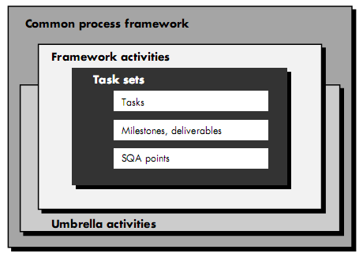
Software process
Software process
(Source: Roger S Pressman, Software Engineering:
A Practitioner's Approach (7th Edition), McGraw-Hill, 2009)

Slide 20
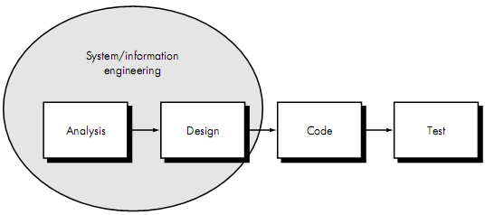
Waterfall model (linear sequential model)
Linear sequential model
(Source: Roger S Pressman, Software Engineering:
A Practitioner's Approach (7th Edition), McGraw-Hill, 2009)

Slide 21
Waterfall model (linear sequential model)
Activities in the real world
Feasibility
study
Requirement
Requirements
Analysis
Models in the real world
Models in a software
Design
Implementation
Software
High quality
software
Testing/verification
Deployment

Slide 22
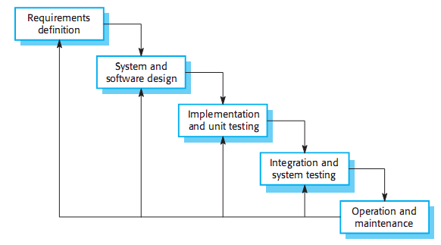
Waterfall model (linear sequential model)
(Revised) waterfall software process model
(Ian Sommerville, Software Engineering (9th Edition), Addison Wesley, 2010)

Slide 23
Waterfall model (linear sequential model)
Feasibility
study
Requirement
Analysis
Design
Implementation
Testing/verification
Deployment

Slide 24
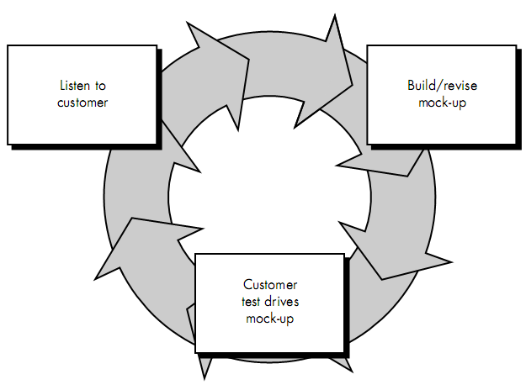
Prototyping model
Prototyping model
(Source: Roger S Pressman,
Software Engineering:
A Practitioner's Approach (7th Edition), McGraw-Hill, 2009)

Slide 25
Prototyping model
Requirement
Quick design
Prototype
Evaluation
Development

Slide 26
Spiral model
Planning
Customer
communication
Custome
evaluation
Risk analysis
Engineering
(analysis & design)
Construction &
release

Slide 27
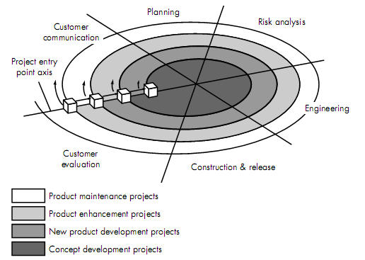
Spiral model
Spiral model
(Source: Roger S Pressman,
Software Engineering:
A Practitioner's Approach (7th Edition), McGraw-Hill, 2009)

Slide 28
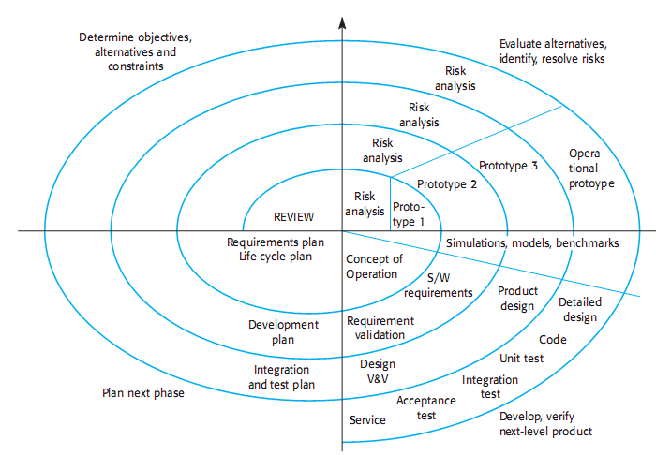
Spiral model
Boehm’s spiral model of the software process
(Ian Sommerville, Software Engineering (9th Edition), Addison Wesley, 2010)

Slide 29
Development of software engineering
Refer to textbooks…

Slide 30
Problems in software development
Refer to textbooks and Module 1: Best Practices of Software Engineering in the course Mastering Object-Oriented Analysis and Design with UML 2.0 by IBM Software Group

